Slide 1
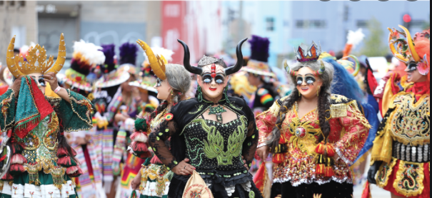
The Anatomy and Craft of Analysis
ACADEMIC WRITING AND SCHOLARSHIP
SSGC8807
Richard Fitzgerald

Slide 2


Slide 3
The Inverted Pyramids
Introduction – Phenomenon
Literature Review on Phenomenon. Research Gap
Data and Methods
Analysis 1, 2, 3
Summary/Conclusion – So what?

Slide 4
The purpose of analysis?
Answer questions
To present the data
Show how the analysis of the data is done
Say something about the data.
Also to...
Persuade – convincing your reader that there is something interesting here and that you have found it
Lining up future papers

Slide 5
Remember: Analysis does not speak for itself.
Different disciplines have different ways of doing this and what counts as analysis.
These have been developed over a long time and may look strange from the outside but are the established ground rules and conventions that underpin the forms of persuasion and evidence for your argument.
Quantitative analysis and the power of numbers. Numbers do the arguing.
Qualitative analysis and the power of observation. Words do the arguing.
But not really – it may look like and be presented as the evidence being objective/factual but it never is – it is always the product of human interpretation– it is an artifact of the researcher’s goals and disciplinary principles.
Analysis is then the art of persuasion using the skills of writing to bring the evidence and argument together.

Slide 6



The Rule of Threes.
Organised around the rule of threes
1. Illustration Identifying the phenomenon?
2 level Depth. Being led into the woods
3. The 3rd level of depth. Arriving at the magic center in the forest.

Slide 7
Each section has a purpose and builds up the layers of the analysis.
Organised around the rule of threes is an ideal structure
1. Illustration (draw the focus to the phenomenon). Ok, you have something interesting.
2 level Depth. (Further layer of depth – Oh I did not see that – that’s interesting) something the reader may not have seen)
3. The 3rd level of depth. The surprise, the kicker the oh wow!

Slide 8
DingTalk – the rule of 3s This, that and the other
Argument Structure
1 - an example - Ok
2 – a collection – wow!
3 – a pattern - Wow wow!
Depth of analysis
1. Phenomena – one star campaign
2. Adding depth to the analysis. – cross platform
3. The kicker, the unexpected. The kickback and the final obliteration of the video

Slide 9

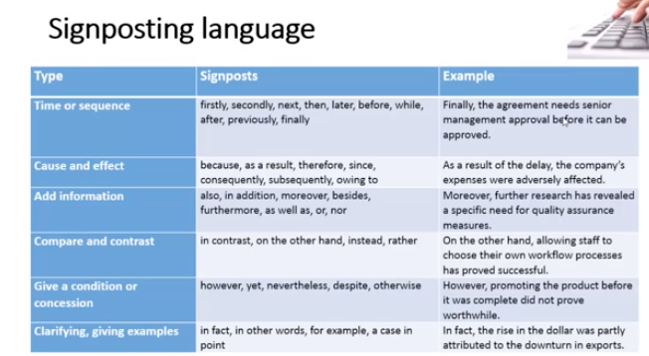
Signposting
You have been working on your article/thesis for ages, even years – you know it inside out – the reader has not – the reader will be reading it for the first time – so you need to guide them through your research.

Slide 10
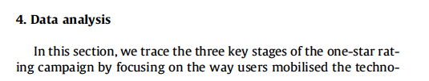
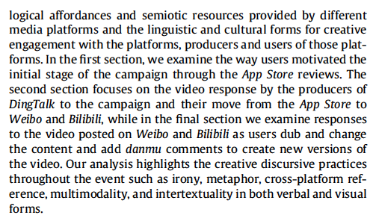
Signposting, signposting, signposting!!! Beginning with a guide for the reader.

Slide 11
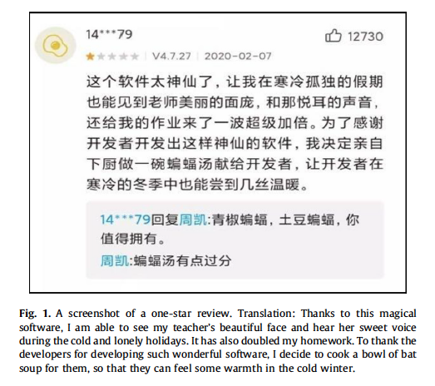
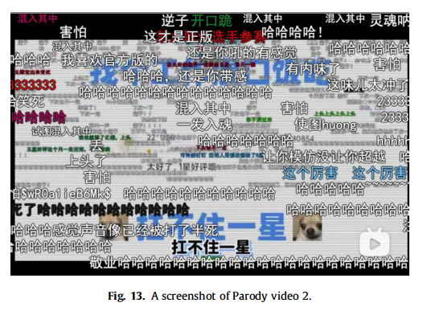
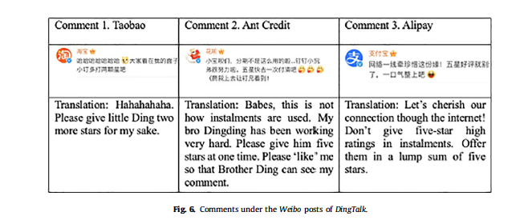
From this
Via this
To this

Slide 12
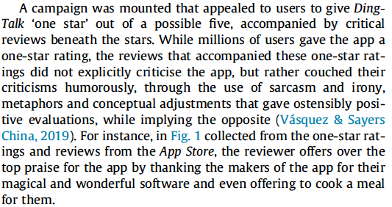
Analysis Section 1. One Star Reviews Establish the Phenomenon

Slide 13
One Star Reviews Identifying the Phenomenon. Example 1

Slide 14
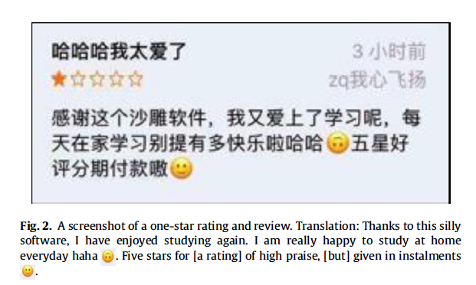
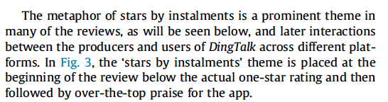
Example 2. Establishing the example as a Phenomena A collection!

Slide 15
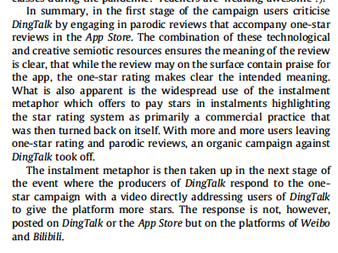
Summary, Section 1. Take Home and link to next section

Slide 16
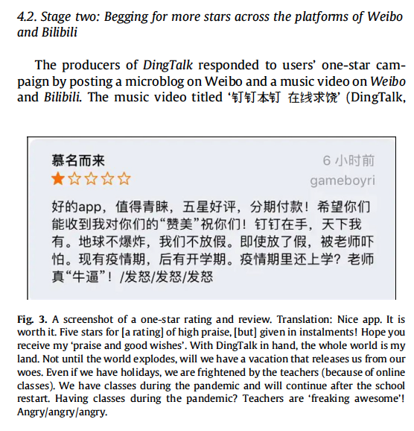
Stage 2 –Example 1. Multiplatform as a Phenomenon

Slide 17
Multiplatform phenomenon of Family Begging for Stars

Slide 18
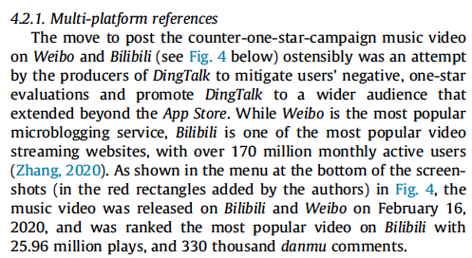
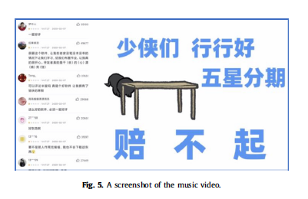
Multiplatform 3 Multiplatform References and Video

Slide 19
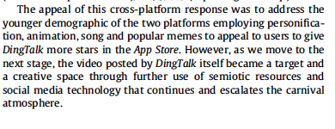
Summary Take home and Link to next section

Slide 20
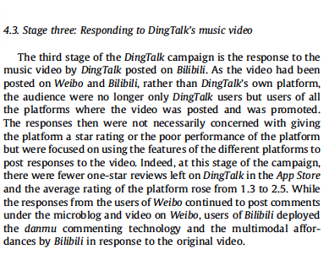
Section 3 Shift Focus to Video Platforms and Danmu 1.

Slide 21
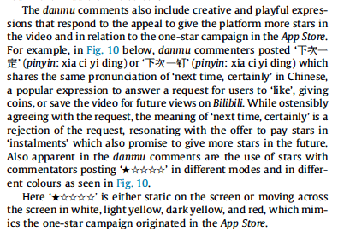
Firstly. Connecting the Analytic Thread of One Star Ratings 1

Slide 22
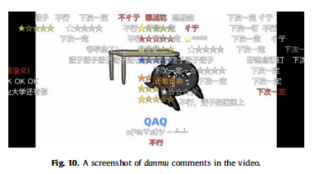
One Stars on Danmu
Some Comments

Slide 23
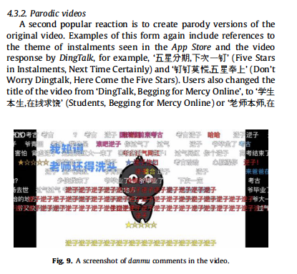
2 Creative Video Content. Danmu Video
More comments

Slide 24
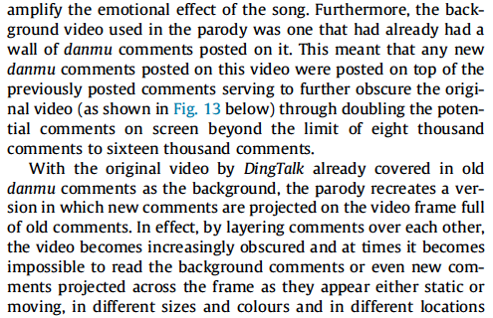
Danmu 3 ‘The kicker!’ Double Danmu!

Slide 25
Danmu 3 Obliteration of the Video

Slide 26
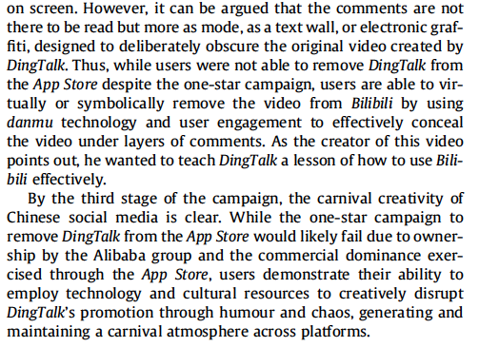
Summary of Section 3 and of the whole Analysis

Slide 27
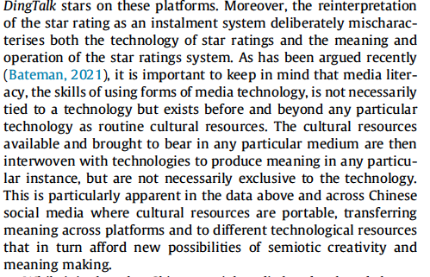
Conclusion. Take Home Point 1. Technology and Creative Resources Across Platforms

Slide 28
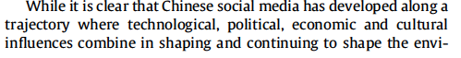
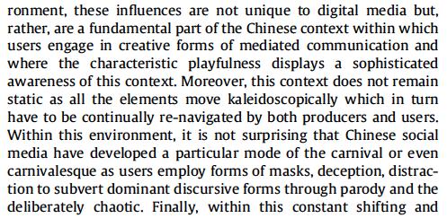

Take Home Point 2. Chinese Social Media ecology is different and evolves.
Drop that in there

Slide 29
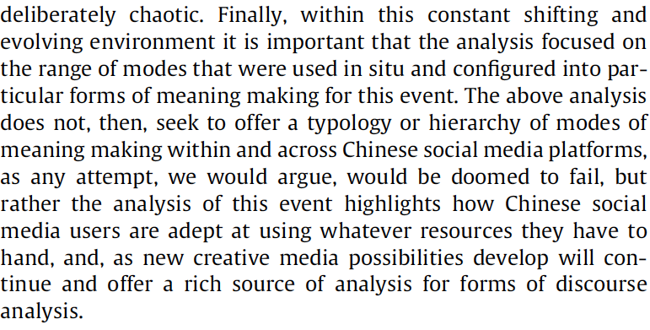
Take Home Point 3. Methodology
Start with the data

Slide 30

Overall Impression Take Away. Chinese Social Media is Multimodal and Carnivalesque

Slide 31
Examples of Summary/Conclusions
Chinese Social Media 1
Hidden in Plain Sight
Chinese Social Media 2
Dingtalk/Bilibili
Diba Expedition

Slide 32
Chinese Social Media. Setting the Scene
4. Summary
In this chapter we set out to briefly sketch out a description of Chinese internet culture from its historical development through to some of its current characteristics. Of course we do not suggest this is any way comprehensive but rather this hopefully gives a sense or flavour of the unique way that political, social and technological forms have, and continue to, influence the way Chinese social media and the internet are developing, and of the innovative ways in which the Chinese engage with this technology. At the heart of this discussion we would argue that discourse analysts will find a rich source of mediated forms of communication in Chinese internet and social media, but that this needs to be treated on its own terms, as a distinct communicative technological and social environment. While, of course, Chinese social media and internet development use has some resonance with other contexts, in China this is increasingly divergent from and creatively different from other contexts. While this would be true of many countries and regions, where internet and social media use have been adapted to particular social and political contexts, China is increasingly taking the lead in both developing its own social media technologies, which are in some cases more advanced than in the West, and in finding creative ways to engage with and through social media between the 772 million users.

Slide 33

Hidden in Plain Sight
Conclusion
This study has explored the expression of political criticism in the context of Internet censorship in China by examining how Weibo users responded to the 2015 Tianjin explosions. Analysis of the Weibo posts after the Tianjin accident examined three main techniques adopted by users to implicitly criticize the local government in handling the event. In turn, this exerted some pressure both on the central government and local authorities to actively respond to public sentiment.
In China where censorship is exerted under the name of protecting its people and maintaining social and political stability, online censors from local to the state levels pay particular attention to information and critical opinions regarding crisis events such as large-scale disasters that often involve politically sensitive topics which, if handled improperly, may lead to public panic and political turmoil. However, social media technologies have endowed the Chinese public with a new form of infrastructure to counter censorship and express critical opinions of the government and authorities through deploying the linguistic and technological resources. ......

Slide 34
....However, despite Chinese users’ successful strategies (including but not limited to the techniques discussed in the study and previous research) at any particular time, Chinese censorship apparatus keeps evolving, becoming ever more sophisticated as each party adapts and evolves with the affordances of technologies. This is not only the ability to shut down or disable a majority of VPNs during important political events, but also to employ over two million people to monitor and censor online content, according to a state media report in 2018 (“China cracks down on video parodies,” 2018). It would then be mistaken to think of these human censors as somehow not aware of the techniques, or lacking the same pragmatic knowledge used by other social media users to circumvent or avoid censorship. That is, censors and monitors should be seen as possessing the same kind of pragmatic competence and shared scheme of interpretation as social media users do, which means that they will be able to identify the political criticism hidden in plain sight once it is there. Therefore, it is fair to say that the proliferation and advances of the Internet and social media technologies not only empower Chinese users with new opportunities to counter the might of the authorities, but they also empower the censors with more sophisticated means to control the public discourse (Albeanu, 2017). In this game of cat and mouse, both Chinese users and censors act and react based on their mutual understanding. Such mutual understanding keeps growing as the Internet censorship apparatus is evolving and the Chinese users are developing new tactics to cope with it.

Slide 35
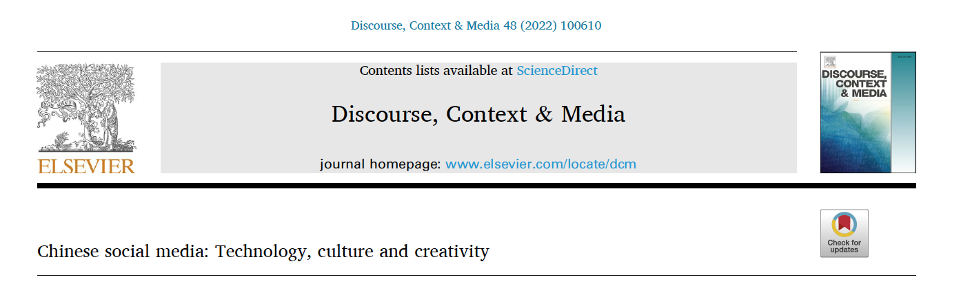
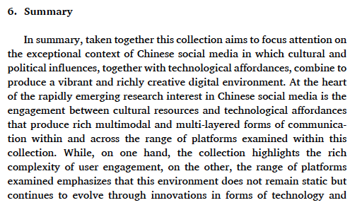
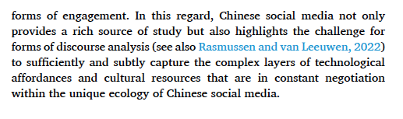

Slide 36
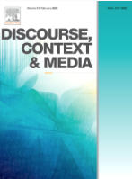
Discussion and conclusion
The above study focused on the 2016 Diba expedition to Taiwan as a form of cyber nationalism. The analysis demonstrated how Mainland users mobilized human, technological, cultural, and multimodal recourses to create and deploy “weapons” for the expedition. Through the creation of banks or collections of prefabricated memes as “weapons”, the Diba Expedition created an “imagined community” (Anderson, 2006) where participants were united through a collaboratively created discourse of nationalism and the enjoined collective goal of defending the “One-China” policy through attacking the pro-independence of Taiwan. This form of nationalism was then mobilized through popular forms of Chinese memes, particularly biaoqingbao, that draws upon popular culture purposed for nationalist statements, making it creative and humorous for engaging with pro-Taiwan independence online users.
It is of course not without irony that this nationalist campaign took place in the context of Chinese online censorship that blocks foreign websites such as Facebook, Twitter, and Google. Under such circumstances, Mainland users needed to use technologies such as VPNs (virtual personal networks) to circumvent censorship and get to the battlefield of Facebook. Moreover, Chinese online censorship also bans discussion of politically sensitive topics in online communication in the Mainland. Thus, on the one hand, Chinese Mainland users sought to fight against the pro-independence of Taiwan to safeguard the unity of the national territory, while on the other hand, they had to do it through circumventing the state government because this campaign broke China’s online security rules and regulations. In this way, the campaign was considered a patriotic movement without the blessing from the government (Han, 2019) while the mainstream official media approved the campaign and believed that it was a kind of cross-strait cultural communication and an online carnival between the young generation of both sides (“社评：不必夸张‘帝吧出征’的两岸负效果 [Editorial: There is no need to exaggerate the negative effect of the cross-strait Diba expedition],” 2016).

Slide 37
…..
Finally, with the increasing interest in the innovative and evolving forms of cyber nationalism facilitated by rapid developments in social media technologies, research from the perspective of multimodal discourse analysis remains an important but underdeveloped area. Based on a social semiotic multimodal analysis of use of nationalist memes in a cyber nationalist event, this study contributes to highlighting the playful, creative and carnivalesque characteristics of new forms of nationalist movements in China. At the same time, the research also highlights the complex digital media ecology of control and censorship that manifests in innovation and creative responses within a layered and constantly shifting environment (Author removed 2021b). Finally, through a multimodal analysis of the nationalist campaign the research also draws attention to the ways in which the Chinese digital environment continues to provide a rich source and an analytic challenge to forms of discourse analysis (Author removed 2022).

Slide 38
Building a Research Trajectory
Chinese Social Media 1 – 2019. (the phenomena) Book Chapter
Hidden in Plain Sight – (illustrate the differences) 2021 Discourse Studies
Chinese Social Media 2 (a unique environment and analytic/methodology challenge) - 2021 Discourse, Context and Media
Dingtalk 2021 – (Carnivalesque/ flexible Memes Spontaneous Cross Platform) Discourse Context and Media
Diba Expedition 2023 – (Organised cross platforms, new audience) Social Semiotics
Danmu Translation – Submitted (Bilibili/Danmu for Translation)
Passing the Whistle – Drafted (Creativity and Platform Censorship)
Health Memes - In Prep* (Regional Humour)
Danmu on News Interviews – Early Stage, Abstract (use of danmu to comment on English news interviews)

